Slide 1
All About GIT, GitHub & Open Source

Slide 2


Abhishek Srivastava
Dhanraj Chavan
Microsoft Learn Student Ambassador
Microsoft Learn Student Ambassador
Notes:
Abhishek:
Founder and Community Lead of DSC VIT Bhopal University
Former development Intern at SurveySparrow and mentor at StudentCode-in
I am a Technical Writer at medium and Full Stack Web developer with an expertise in React and Django.

Slide 3

GIT
Distributed Version Control System
https://git-scm.com/
Notes:
Git is a distributed version-control system. which is used for tracking changes in any set of files.
It was originally designed for coordinating work among programmers cooperating on source code during software development.
Its goals include speed, data integrity, and support for distributed, non-linear workflows This is useful for 3 different types of people:
Never used Version control before. git is great place to share.
Have used VCS, but not GIT, have used SVM. It would be great to know about GIT
Who have GIT, but mainly used GIU tools. It’s better to learn command line tools

Slide 4
What is a difference between Central and Distributed
VCS?
Notes:
A version control system is a kind of software that helps the developer team to efficiently communicate and manage(track) all the changes that have been made to the source code along with the information like who made and what change has been made
SVM was CNS

Slide 5
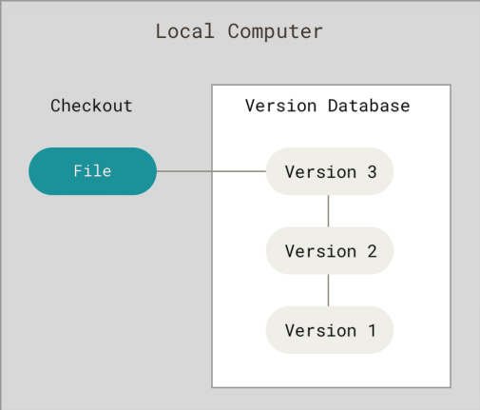
Central VCS (SVN)
Notes:
In Central VCS, Everything is located at one place so people can check in and check out when making changes
PROBLEM: If you don’t have access to that central server or central repository, for ex:
server if offline
you don’t have internet
then you will only able to see the files you checked out last time from that repo
If somehing happens or data is currupted, lost everything

Slide 6
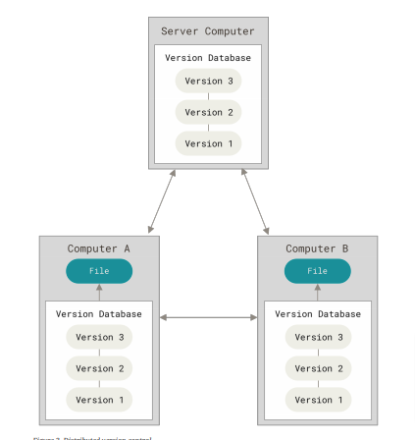
Distributed VCS (GIT)
Notes:
On the other hand a Distri. VCS like GIT, in this everybody has a local repository. Your local repo has all options that your remote repo has based on the last time your sync those two together.
Good thing is If you don’t have access to remote repo, you can still view all changes that are made to that repo
So in a way, Its is like every developer has a backup of entire repository. That’s why its called Distri. VCS

Slide 7
INSTALLING GIT
Go to https://git-scm.com/

Slide 8
FIRST TIME SETUP

Slide 9

CHECK VERSION
git --version

Slide 10
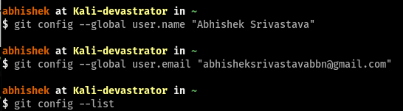
SET CONFIG VALUES
$ git config --global user.name "Abhishek Srivastava"
$ git config --global user.email "abhisheksrivastavabbn@gmail.com"

Slide 11
NEED HELP ?
git help <verb>
git <verb> --help
Example:
git config --help
git help config

Slide 12
GETTING STARTED

Slide 13
INITIALIZE A REPOSITORY
FROM EXISTING CODE
BEFORE FIRST COMMIT
$ git init
$ git status

Slide 14
ADD .gitignore FILE
$ touch .gitignore
Sample .gitignore file
.DS_Store
.project
*.pyc
Notes:
before adding git status .project will appear in untracked

Slide 15
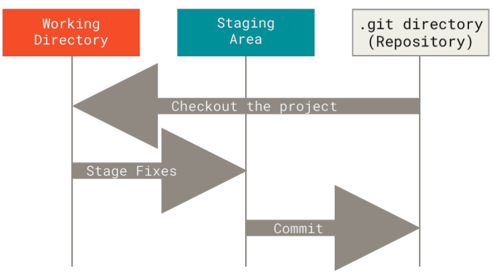
WHERE ARE WE NOW ?

Slide 16
ADDING FILES TO STAGING AREA
REMOVE FILES TO STAGING AREA
$ git commit -A
$ git status
$ git reset
$ git status

Slide 17
MAKING OUR FIRST COMMIT
$ git add -A
$ git commit -m “Initial Commit”
$ git status
$ git log

Slide 18
CLONING A REMOTE REPO
VIEWING INFORMATION
$ git clone <url> <where to clone>
$ git clone ../remote_repo.git
$ git remote -v
$ git branch -a

Slide 19
PUSHING CHANGES
COMMIT CHANGES LIKE WE DID PREVIOUSLY
THEN PUSH
$ git diff
$ git status
$ git add -A
$ git commit -m “Modified Commit”
$ git pull origin master
$ git push origin master

Slide 20
COMMON WORKFLOW
CREATE A BRANCH OF YOUR DESIRED FEATURE
MAKE CHANGES, ADD AND COMMIT THEM PUSH TO REMOTE
$ git branch <branch_name>
$ git checkout <branch_name>
$ git add -A
$ git commit -m “new feature”
$ git push -u origin <branch_name>

Slide 21
COMMON WORKFLOW
MERGE A BRANCH
DELETING A BRANCH
$ git checkout main
$ git pull origin main
$ git branch --merged
$ git merge <branch_name>
$ git pull origin main
$ git branch --merged
$ git branch -d <branch_name>
$ git branch -a
$ git push origin --delete <branch_name>

Slide 22
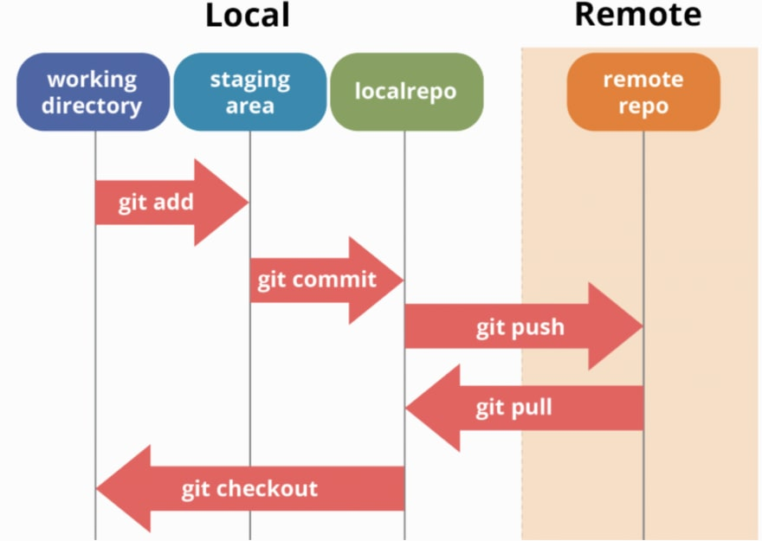
COMMON WORKFLOW

Slide 23
That’s a lot of GIT,
Let’s dive into GITHUB

Slide 24

GITHUB
Code hosting platform for version control and collaboration
Notes:
This is useful for 3 different types of people:
Never used Version control before
Have used, but not GIT, have used SVM
Who have GIT, but not experts
GitHub offers Cloud Based repo Hosting Service

Slide 25
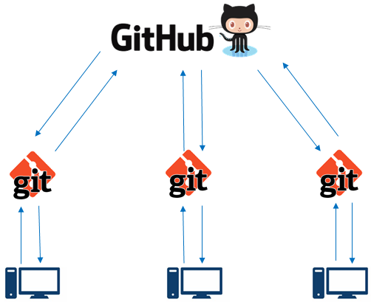
Git Vs GitHub
Git | GitHub
Installed locally | Hosted in Cloud
Version Control System | Code Collaboration Platform
Git is Command Line Tool that requires an interface to interact with world | GitHub is Graphical Interface & Development Platform created for developers
No User Management Features | Built-In User Management Features
It stores & catalog changes in code in Repository | It provides a platform as a collaborative effort to bring teams together

Slide 26
Let’s Go To GitHub Quick Tour
www.github.com

Slide 27
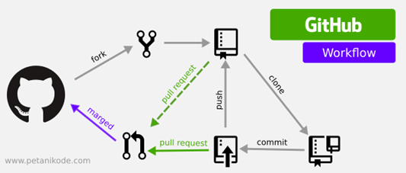

Slide 28

GitHub Student Developer Pack
https://hackernoon.com/guide-to-githubs-student-developer-pack-in-2020-qrx3uk6

Slide 29

Open Source
Something that is designed to be publicly accessible

Slide 30


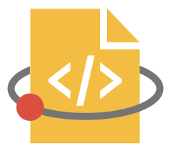

Open Source Programs
Google Summer of Code
MLH Fellowship
linux foundation (lfn) mentorship program
Season of Docs

Slide 31




Open Source Programs
Outreachy
Season of KDE
Foss Asia Codeheat
Open Mainframe Mentorship Project

Slide 32




Open Source Softwares
Firefox
OpenOffice
Gimp
MySQL
Notes:
Example Open Source Project (Signal)

Slide 33




Open Source Softwares
Open Source Softwares
Marketcetera
Ingres
Asterisk
Zimbra

Slide 34
Any Questions?

Slide 35
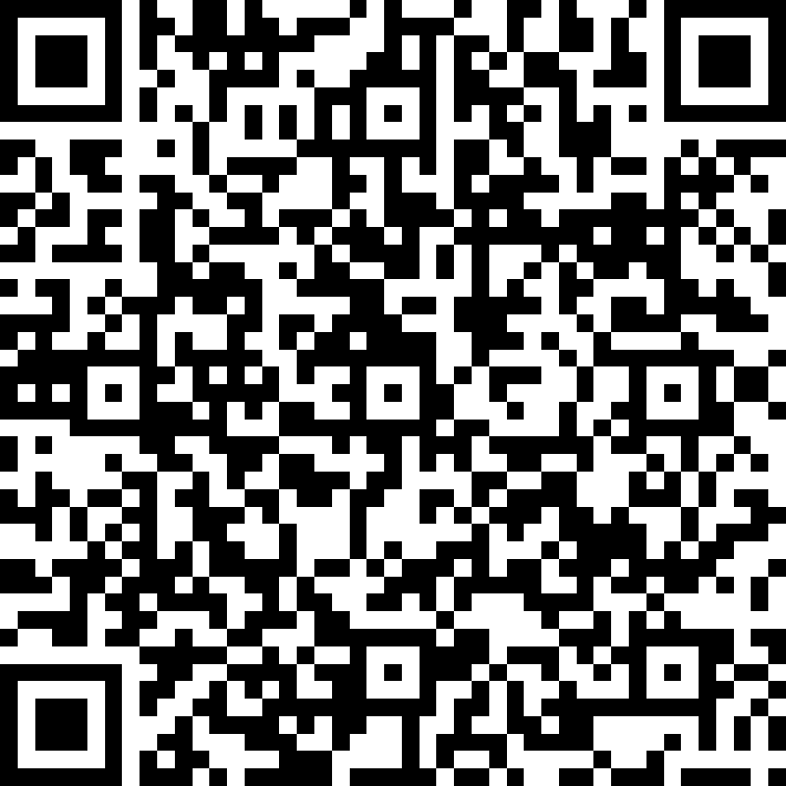
Thank You for attending the session!
Abhishek Srivastava
Dhanraj Chavan
bit.ly/mlsa-feedback
Microsoft Learn Student Ambassador
Microsoft Learn Student Ambassador

